Slide 1

Data Analysis for Canola and Mustard Yield
Utilizing Clustering Crop Yield Analysis - RM Level

Slide 2
Data
Canola & Mustard Yield
G of SK
GIS G of SK

Slide 3
Exploratory Analysis

Slide 4
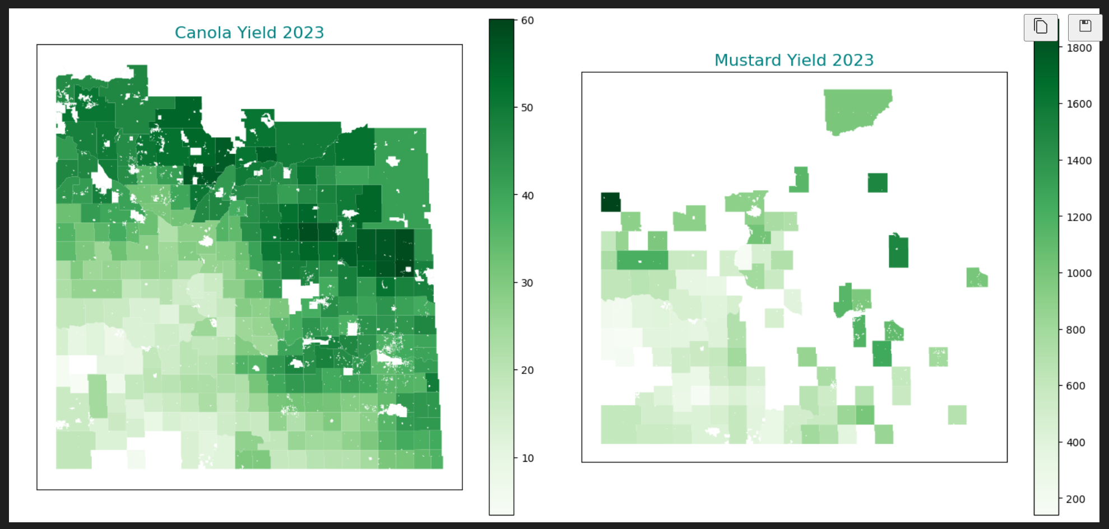
Canola and Mustard Yield 2023

Slide 5
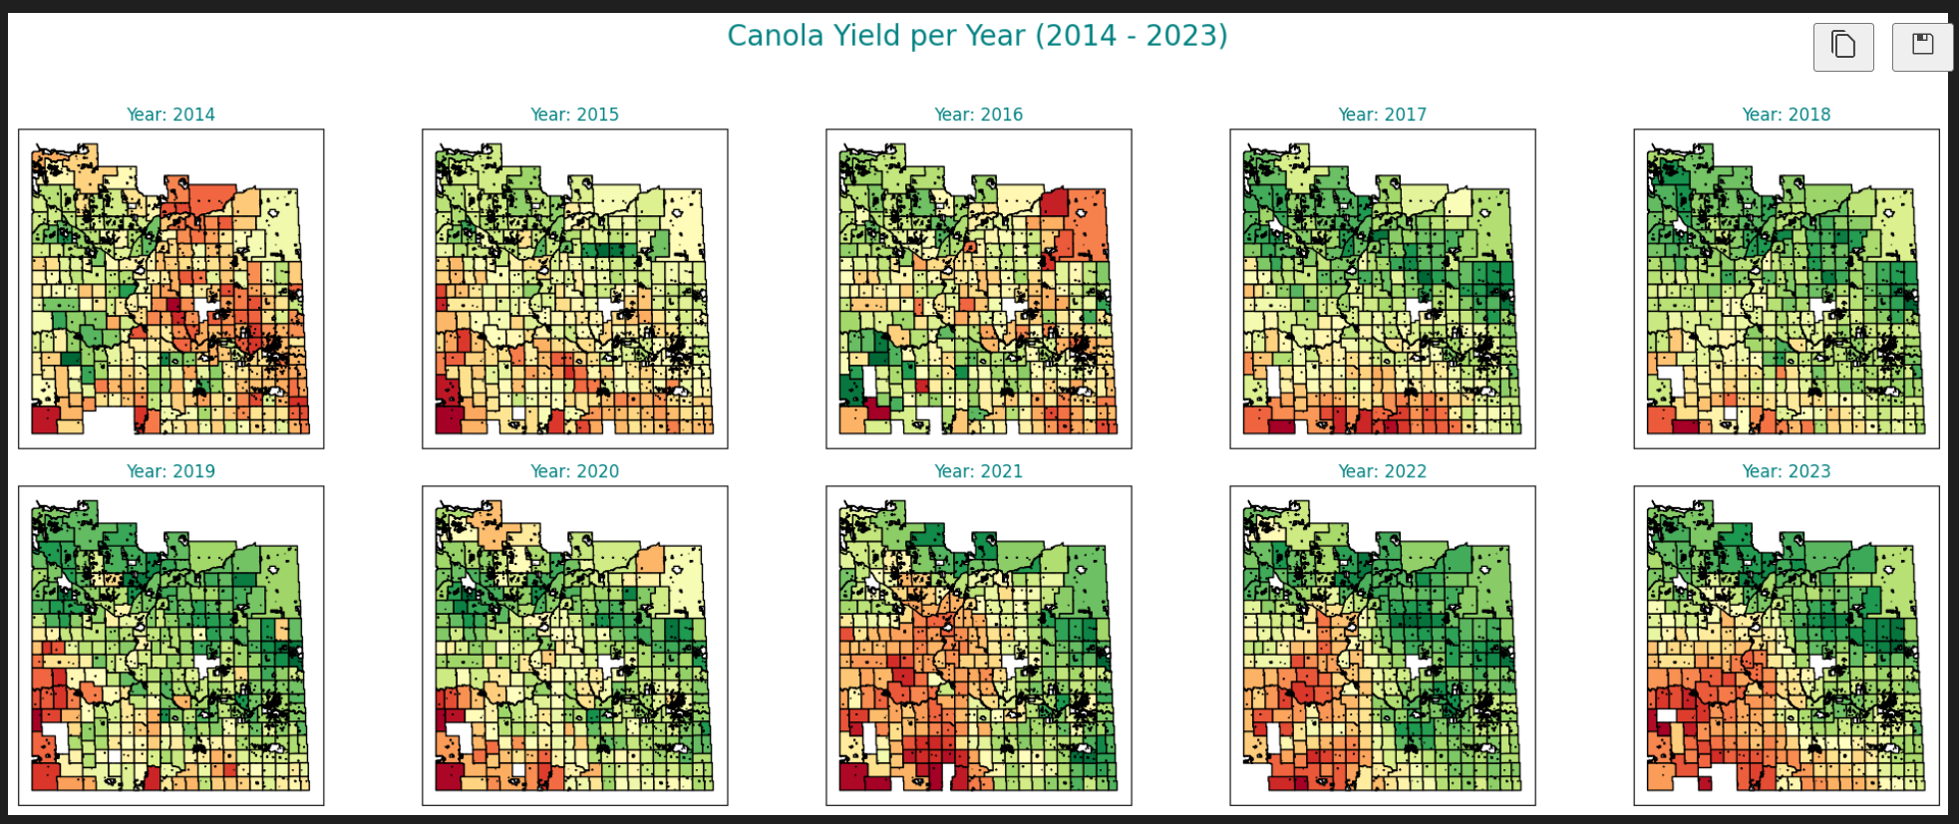
Canola Yield Last 10 Years

Slide 6
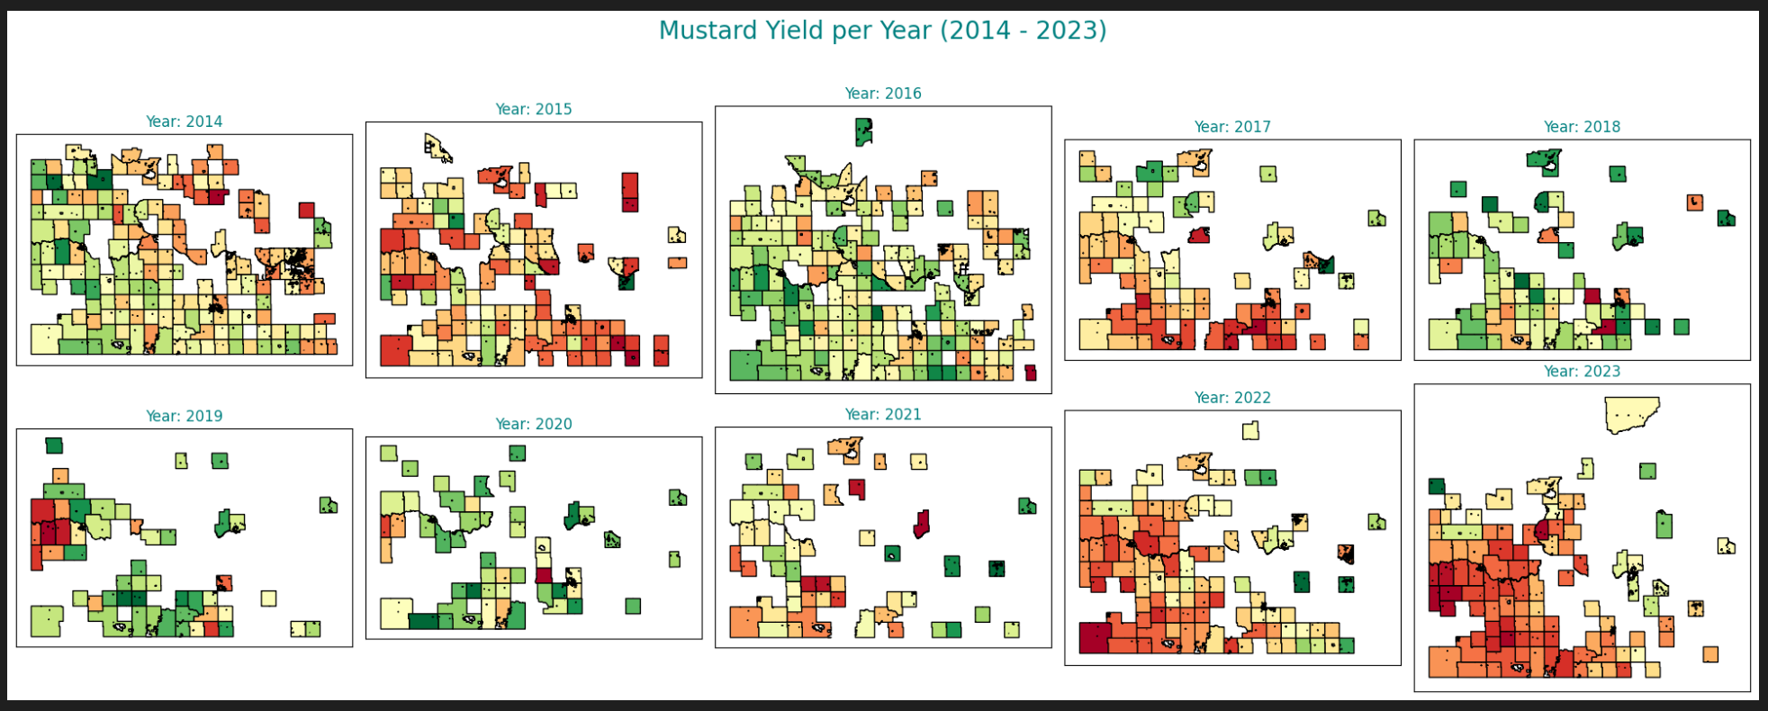
Mustard Yield Last 10 Years

Slide 7
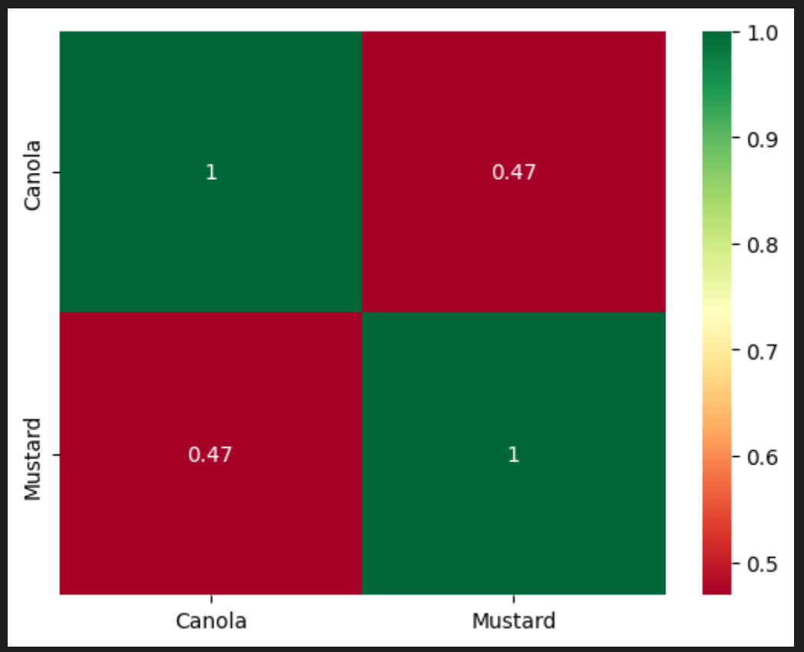
Correlation Matrix

Slide 8
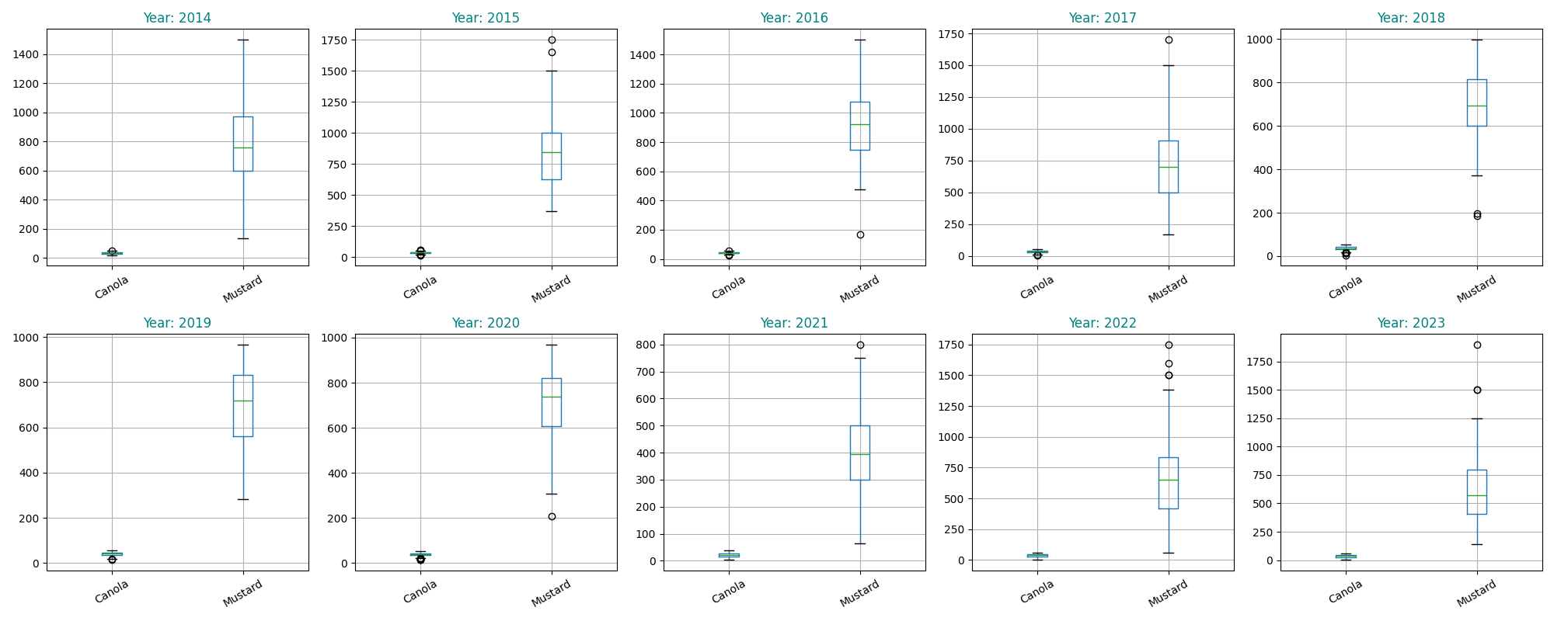
Outliers Before Treatment

Slide 9
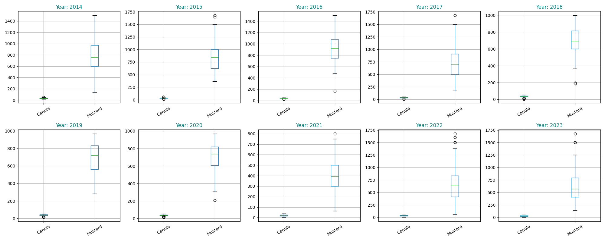
Outliers After Treatment

Slide 10
Clustering Analysis

Slide 11
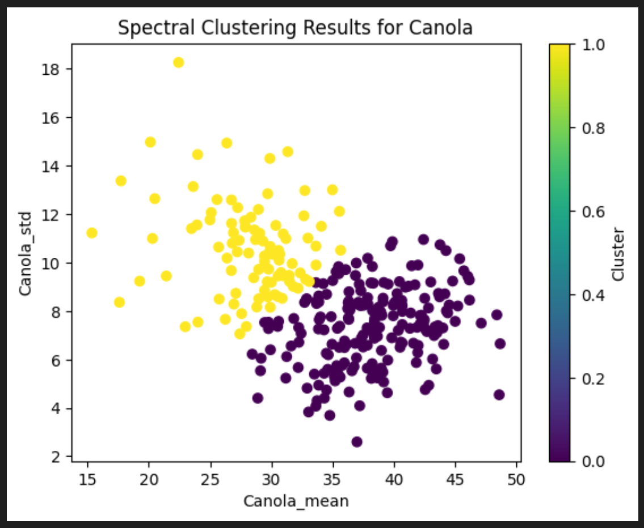
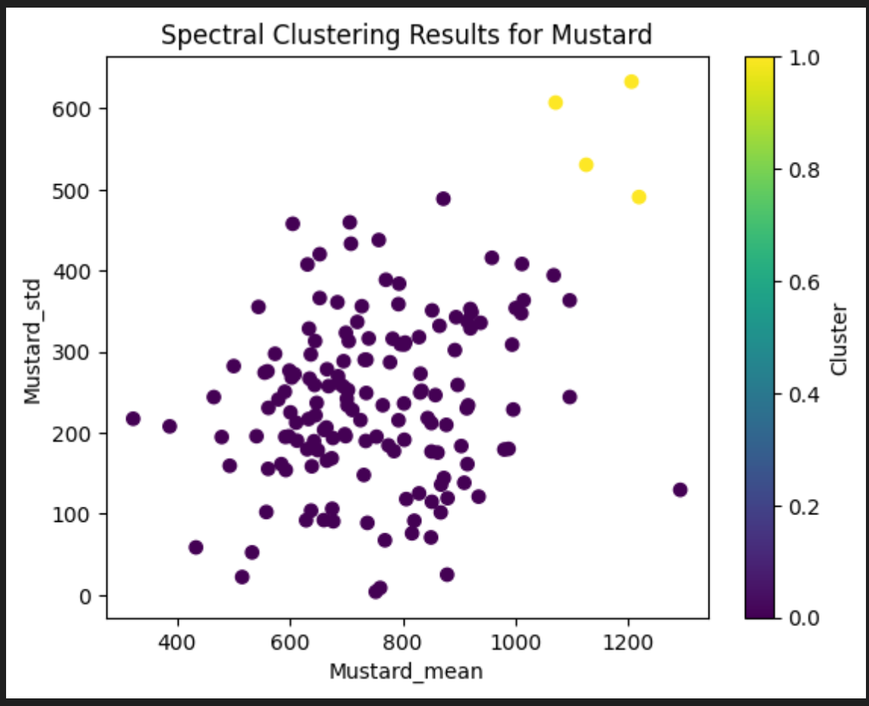
Spectral Clustering

Slide 12
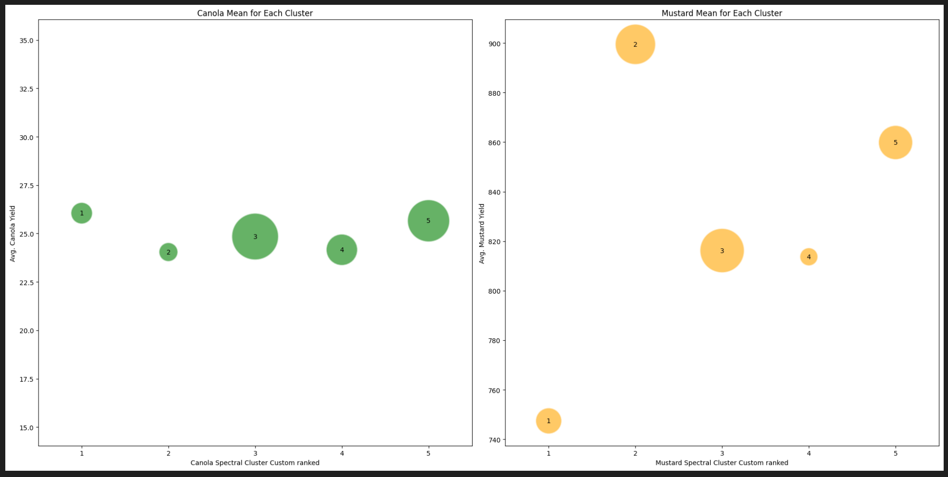
Bubble Clustering

Slide 13
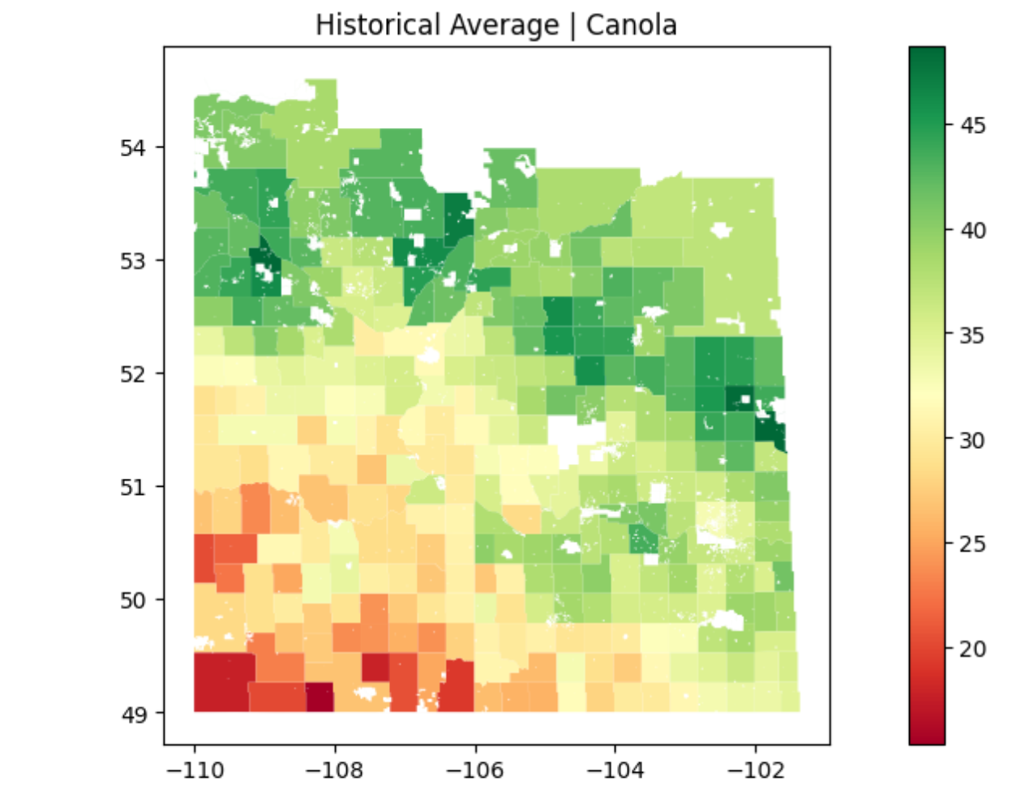
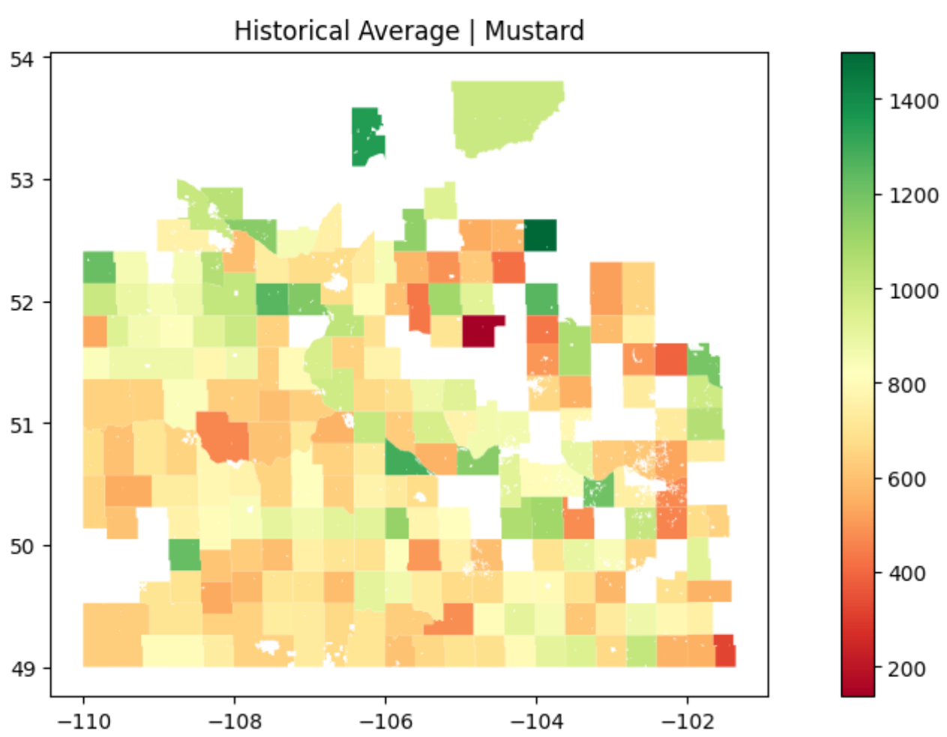
Historical Average Yield

Slide 14
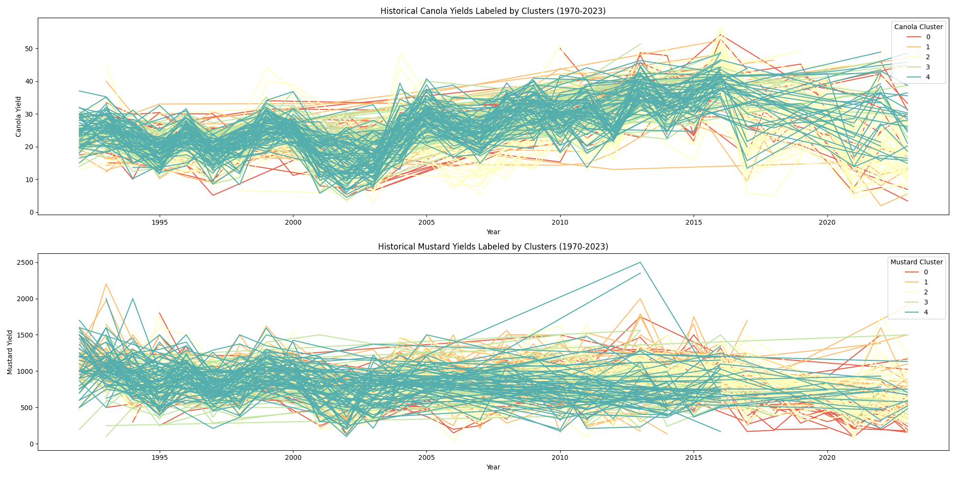
Historical Yield Levelled by Cluster

